Slide 1
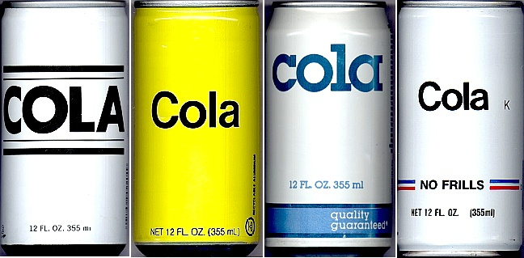
C♯ Generics, Collections, Iterators, and Regular Expressions
Rasmus Lystrøm
Associate Professor
ITU
This Photo by Unknown Author is licensed under CC BY-SA

Slide 2

Parametric Polymorphism – “Generics”

Slide 3

Generics
Built-in
Iterators
Collections
Create your own?
Type Constraints
(Co- and contravariance)

Slide 4
ArrayList → List<T>
// Non-generic
IList list = new ArrayList();
list.Add("hello");
var s = (string)list[0];
// Generic
IList<string> list = new List<string>();
list.Add("hello");
var s = list[0];

Slide 5
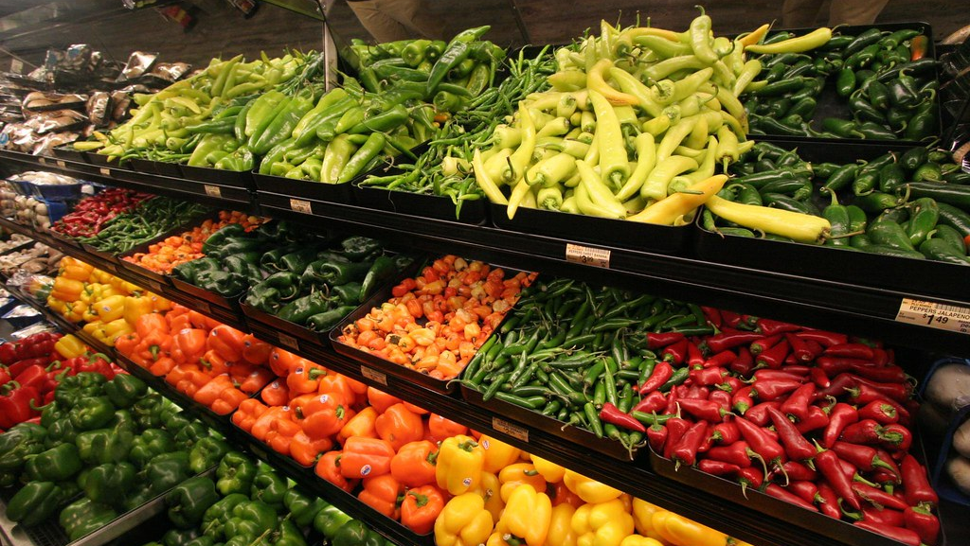
Iterators
This Photo by Unknown Author is licensed under CC BY-NC-ND

Slide 6
Iterators
IEnumerable
IEnumerator
yield return T;
yield break;
IEnumerable<out T>
IEnumerator<out T>
Covariance
Producer
foreach (var item in items)
{
}
Building block for LINQ

Slide 7
Iterators
Demo

Slide 8

Generic collections

Slide 9
System.Collections
IEnumerable
IList
ArrayList
ICollection
Hashtable
IDictionary
SortedList
Stack
ArrayList
Queue

Slide 10
System.Collections.Generic
IEnumerable<T>
IList<T>
List<T>
ICollection<T>
HashSet<T>
ISet<T>
SortedSet<T>
Stack<T>
LinkedList<T>
Queue<T>

Slide 11
System.Collections.Generic 2
IEnumerable<T>
IEnumerable<KeyValuePair<K, V>>
ICollection<T>
ICollection<KeyValuePair<K, V>>
IDictionary<K, V>
Dictionary<K, V>
SortedDictionary<K, V>

Slide 12
System.Collections.Concurrent
ICollection<T>
IDictionary<K, V>
IProducerConsumerCollection<T>
ConcurrentDictionary<K, V>
ConcurrentStack<T>
ConcurrentQueue<T>
ConcurrentBag<T>

Slide 13
Generic Collections
Demo

Slide 14
Create your own generic class 2
class MyMap<TKey, TValue>
{
void Add(TKey key, TValue value) { }
bool ContainsKey(TKey key) { }
bool ContainsValue(TValue key) { }
TValue this[TKey key] { get; set; }
}

Slide 15
Create your own generic method
public string Serialize<T>(T obj) {}
public T2 Convert<T1, T2>(T1 obj) { }

Slide 16
Type constraints
public class MyConstrainedGenericClass<T>
where T : class, new() { }
public class MyConstrainedGenericClass<T>
where T : struct { }
public class MyConstrainedGenericClass<T1, T2>
where T1 : Foo
where T2 : IBar { }
public T2 MyConstrainedMethod<T1, T2>(T1 item)
where T1 : Foo
where T2 : IBar, new() { }

Slide 17
Custom Generics
Demo

Slide 18

Covariance – Contravariance – Invariance?

Slide 19
Variance
Covariance
Enables you to use a more derived type than originally specified.
You can assign an instance of IEnumerable<Derived> to a variable of type IEnumerable<Base>.
Contravariance
Enables you to use a more generic (less derived) type than originally specified.
You can assign an instance of Action<Base> to a variable of type Action<Derived>.
Invariance
Means that you can use only the type originally specified. An invariant generic type parameter is neither covariant nor contravariant.
You cannot assign an instance of List<Base> to a variable of type List<Derived> or vice versa.
https://docs.microsoft.com/en-us/dotnet/standard/generics/covariance-and-contravariance

Slide 20
Built-in generics
public interface IComparer<in T>
{
int Compare(T x, T y);
}
public interface IEnumerable<out T> : IEnumerable
{
IEnumerator<T> GetEnumerator();
}
Contravariance
Covariance
https://docs.microsoft.com/en-us/dotnet/standard/generics/covariance-and-contravariance

Slide 21
Covariance and Contravariance
Demo

Slide 22
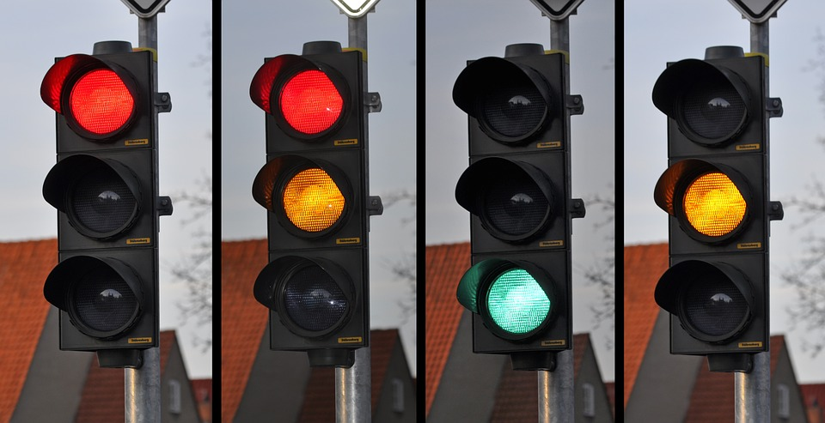
Enumeration Types

Slide 23
Enumeration Types
Demo
https://docs.microsoft.com/en-us/dotnet/csharp/language-reference/builtin-types/enum

Slide 24

Regular Expressions

Slide 25
Regular expressions 1
* | Zero or more times the previous character
+ | Once or more times the previous character
? | Zero or one time the previous character
. | Any single character (not \n)
\s | Any whitespace character (e.g. tab)
\S | Any non-whitespace character
\b | Word boundary
\B | Any non-word boundary position
\w | Any word character (a-z, A-Z, 0-9)
\W | Any non-word character
^ | Start of the input text
$ | End of the input text

Slide 26
Regular expressions 2
[1c] | matches character ‘1’ or ‘c’
[a-z] | matches all lower-case letters
[a-zA-Z] | matches all letters
[0-9]+ | matches integer numbers
[0-9]+\.[0-9]+ | matches a floating point
[0-2][0-9]:[0-5][0-9] | matches a time e.g. 12:34
https://docs.microsoft.com/en-us/dotnet/standard/base-types/regular-expression-language-quick-reference

Slide 27
Regular expressions 3
[^abc] | matches character not in ‘a’, ‘b’, or ‘c’
(capture) (?:non) (?<name>name) | capturing group, non-capturing group, named capturing group
[a-z]+(\d{5}) | matches a standard Danish license plate where the numeric part is a capturing group
(?<given_name>\w+) (?<surname>\w+) | matching a given name followed by a surname (named capturing groups)
(?:Jane|John) (\w+) (?:Doe) | matching the middle name of Jane or John Doe
https://docs.microsoft.com/en-us/dotnet/standard/base-types/grouping-constructs-in-regular-expressions

Slide 28
Regular Expressions
Demo

Slide 29

Thank you

